Slide 1
Keyword Search in Spatial Databases: Towards Searching by Document
Dongxiang Zhang, Yeow Meng Chee, Anirban Mondal, Anthony K. H. Tung, Masaru Kitsuregawa
Atish Majumdar 1410110081
Prasanna Natarajan 1410110298
Vedant Chakravarthy 1410110489
1 | 2 | 3 | 4 | 5 | 6
1 | | | | | 6

Slide 2
SUMMARY
In a database of spatial objects, every tuple is associated with certain information represented by keywords.
Novel proposals:
m-closest keywords (mCK) query – spatial, helps find tuples which are located in the closest spatial proximity that align with the user-entered keywords.
bR*-tree - process mCK queries
A priori based search approaches are used to decrease the total search space.
1 | 2 | 3 | 4 | 5 | 6
1 | | | | | 6

Slide 3
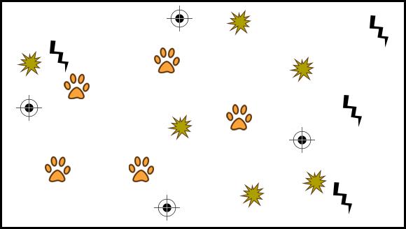
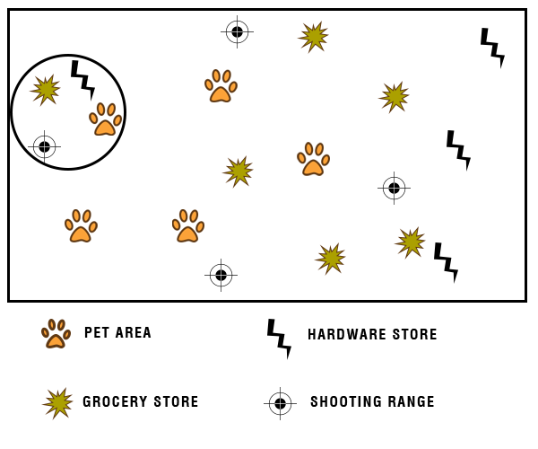
MOTIVATION
1 | 2 | 3 | 4 | 5 | 6
1 | | | | | 6

Slide 4
RELATED WORK
Spatial queries
Nearest neighbour
Range
Closest Pair
NIRIBB*
*Non-incremental recursive and iterative branch and bound algorithm
1 | 2 | 3 | 4 | 5 | 6
1 | | | | | 6

Slide 5
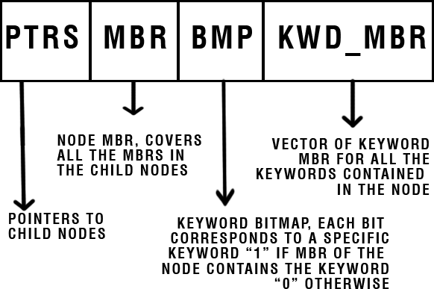
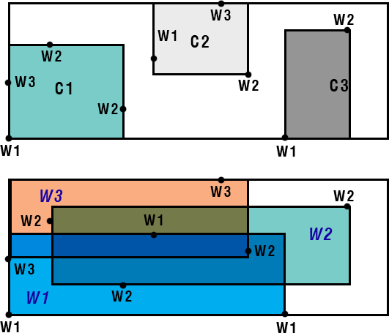
PROBLEM SETUP | SOLUTION DESCRIPTION
Set of all keywords = {q1, q2, q3, q4, q5}
Keywords in node B = {q1,q4}
Bitmap B = 10010
bR*-tree node
1 | 2 | 3 | 4 | 5 | 6
1 | | | | | 6

Slide 6
PROBLEM SETUP | SOLUTION DESCRIPTION
Find m closest keywords
Search either single or multiple nodes
Prune using distance and keyword mutex
1 | 2 | 3 | 4 | 5 | 6
1 | | | | | 6

